Slide 1
SMSA & THE FINTECH SANDBOX
Group 6:
Reem AlQhatani​
Hussein Ali Buhligah​
Afrah AlHarbi​
Heba AlJassir
Ahmed ALGhazal​

Slide 2





Getting instant bill financing just got easier!
Instant cash!
Now you can receive your payments in advance through the Lindo crowdfunding platform, what are you waiting for?
Investors
SME

Slide 3
Since the Startups and small to medium enterprises (SMEs ) represent a big sector in the Saudi economy and these small businesses could face financial challenges, The Lendo platform provide efficient solutions:
Financing the Startups and small to medium enterprises (SMEs) with small profits.
Help making the best financing decisions by providing financial advisor.
great opportunity for Startups and SMEs to show their business via an online platform

Slide 4








Faster & Easier
100% Free
Personal Loans
Bank Account
Credit Cards
Car Finance
Home Finance

Slide 5
The One Step Shop
Currently the website is performing in a sandbox stage to get familiarized with the service and to integrate with other banks.
This website and service is licensed by SAMA (Saudi Arabia Central Bank) as per their risks mitigations and approval to meet the criteria.
The great benefit of this serves to be as a referral service to the credit brewers such as banks. However, the idea of this webservice to minimize the time of shopping for (auto-loan, credit card, mortgage, personal loans) . Getting the best and lowest interest rates would simplify the selection for the buyers.
The most challenging for the service is to have good communication plan to engage with these banks to have the last criteria and rates.

Slide 6







Monitor your expenses and get detailed
reports on your paymentsa
Your trust is important to us and your safety is our priority
Secure
Auto-Compilation
Easy & Fast
Smart

Slide 7
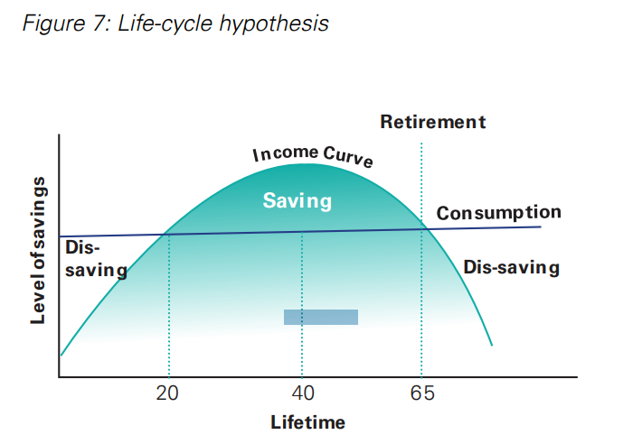
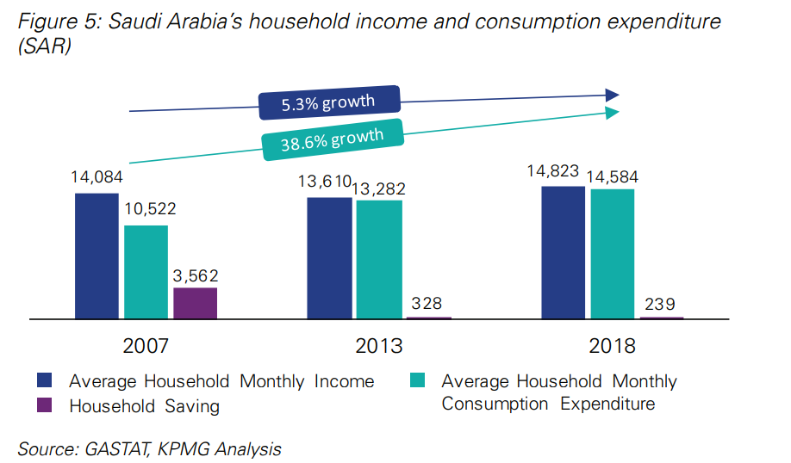
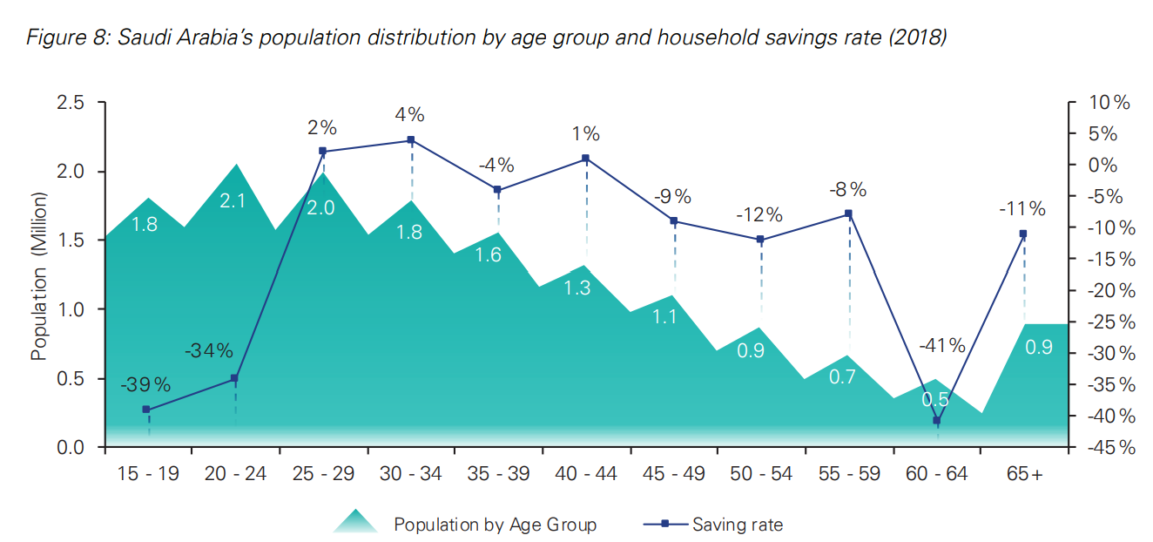
Manage your income easily from one place
Financial Literacy
Inclinations toward spending
Age distribution

Slide 8
Crowdfunding
Retail Banking E-Broker and Aggregator
Financial Monitoring, Saving

Slide 9
THANK YOU
For Your Attention

